Slide 1

Four ways to stay safe from
coronavirus.
Notes:
這是您的實驗所要解答的問題

Slide 2
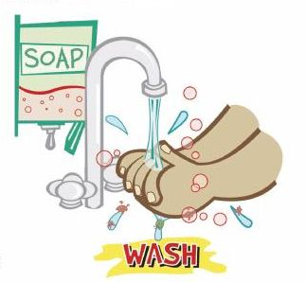
1. ~ Wash your hands.
Always wash your
hands with soap.

Slide 3

2. ~ Wear a mask.
Remember wearing
a mask in the enclosed
area.

Slide 4

3. ~ Avoid public places.
Avoid going to
public places if it’s
not necessary.

Slide 5
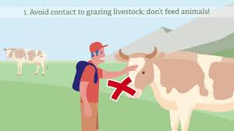
4. ~ Avoid contact with animals.
Avoid contact with
wild animals.

