Slide 1
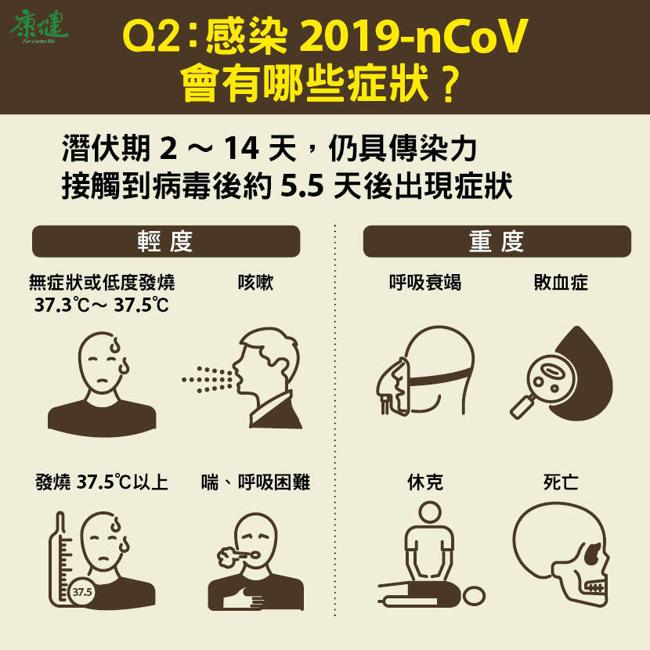

Slide 2
What are the symptoms of coronavirus?
冠狀病毒的症狀?

Slide 3
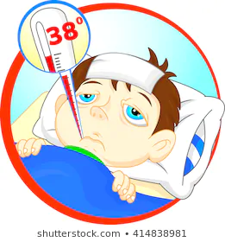
fever

Slide 4

cough

Slide 5
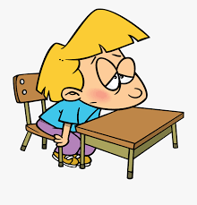
tired
tiredness

Slide 6
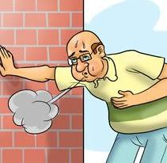
short
shortness of breath

Slide 7
I have a .
I don’t have a .
I have .
I don’t have .

Slide 8
I’m tired.
I feel tired.
He’s tired.
He feels tired.

